Slide 1
Digital Zoom
By Ido W. and Dvir H.
May, 2025

Slide 2
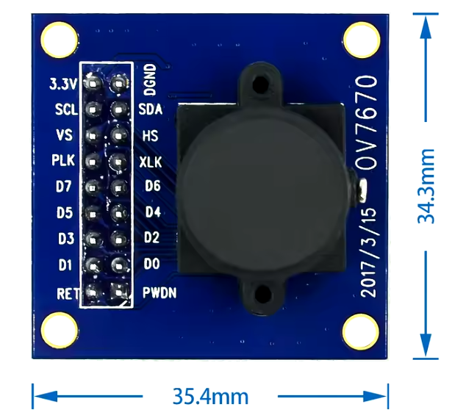
System Overview
Goals:
digital zoom on FPGA:
Operates OV7670 camera as input and VGA monitor for display.
Implement zoom x 2.
Solve zoom pixelation by Bilinear Interpolation.

Slide 3
Project’s steps
Architecture – Key FPGA Modules.
Code implementation (RTL)
Simulations
Synthesis
Place & Route - .xdc

Slide 4
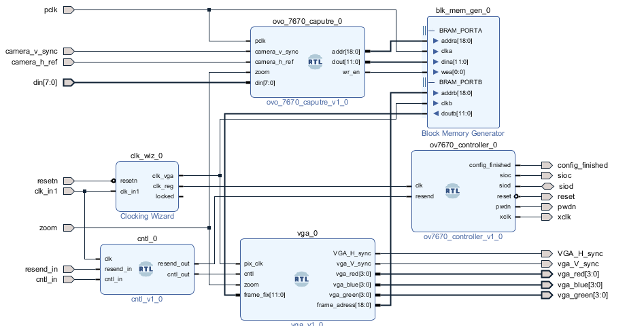
Architecture – Key FPGA Modules.
Capture → BRAM → VGA
Capture → Zoom → BRAM / 4 → VGA
Initial architecture:

Slide 5
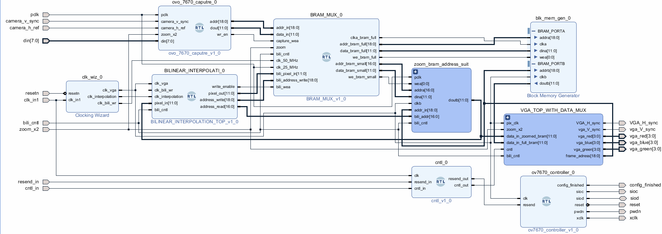
Architecture – Key FPGA Modules.
Capture → Zoom → BRAM2 → Bili → BRAM1 → VGA
Capture → Zoom → BRAM2 → VGA
Capture → BRAM1 → VGA
Final architecture:

Slide 6
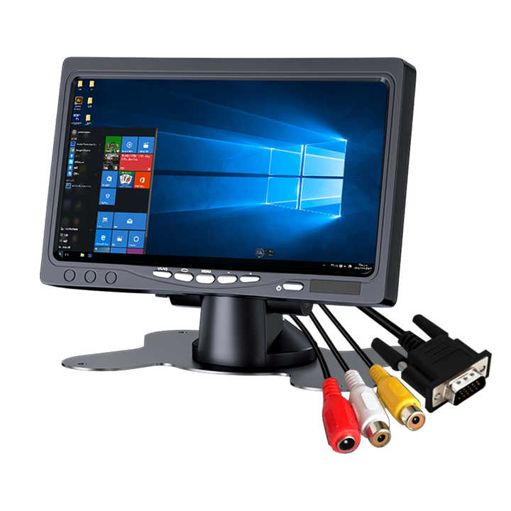
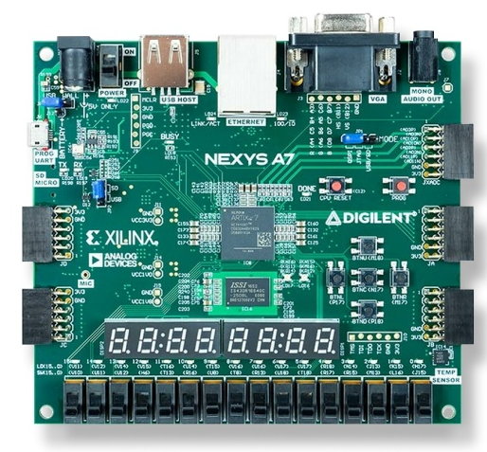
Flow – block diagram
Sync signals, pixels
Pixel data, clk, sync signals
SCCB Config, clk, reset

Slide 7
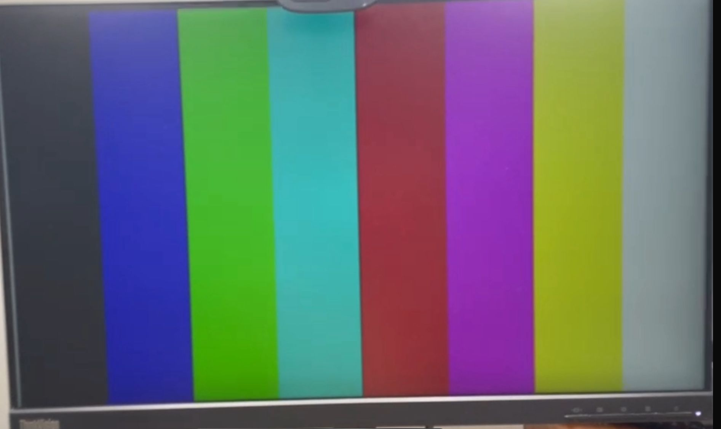
Main State Machine
Idle – No VGA
Active VGA -
Rainbow screen
Camera Display 640×480
Camera tuning setup
reset
Camera cntl
config
zoom
Zoom x 2
filtered
640x480
Zoom x 2
Cropped
320x240
Bili cntl

Slide 8
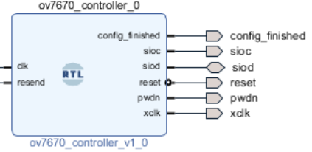
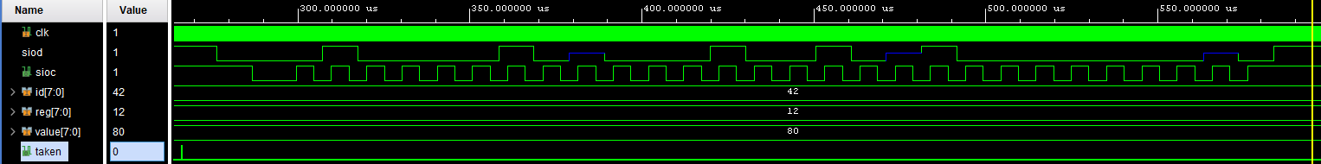

Module: Controller
Config, clk, reset
Configure registers with protocol SccB (I2C like), 97.65KHz
$f_{SIOC}=\frac{25Mhz}{256}≈100KHz$
B"01000010" = x"42"
B“1000_0000" = x“80"

Slide 9
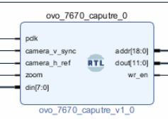
Module: Capture
Capture → BRAM → [VGA]
Pixels data, clk, sync signals
Collects pixel data by sampling two consecutive 8-bit values to form one pixel.
Converts camera data from RGB565 to RGB444 (to match the board’s VGA pin format).
Writes the pixel data to BRAM.
Zoom mode – stores only the center portion of the image pixels in BRAM.

Slide 10
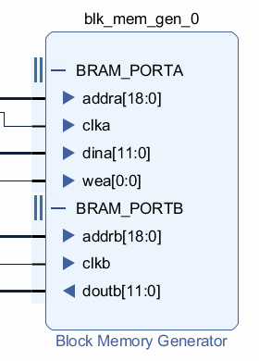
Module: BRAM
Capture → BRAM → [VGA]
Collects pixel data by sampling two consecutive 8-bit values to form one pixel.
Converts camera data from RGB565 to RGB444 (to match the board’s VGA pin format).
Writes the pixel data to BRAM.
Zoom mode – stores only the center portion of the image pixels in BRAM. (Use only ¼ BRAM)
Storge size:
Width 12 bits (= 1 pixel)
Depth 307,200 (= 640x480)

Slide 11
Module: BRAM
Capture → BRAM → [VGA]
Collects pixel data by sampling two consecutive 8-bit values to form one pixel.
Converts camera data from RGB565 to RGB444 (to match the board’s VGA pin format).
Writes the pixel data to BRAM.
Zoom mode – stores only the center portion of the image pixels in BRAM. (Use only ¼ BRAM)
Storge size:
Width 12 bits (= 1 pixel)
Depth 307,200 (= 640x480)

Slide 12
Two Content Layout with Table
First bullet point here
Second bullet point here
Third bullet point here
Class | Group 1 | Group 2
Class 1 | 82 | 95
Class 2 | 76 | 88
Class 3 | 84 | 90

Slide 13
Title and Content Layout with SmartArt
Step 1 Title
Step 2 Title
Task description
Task description
Task description
Task description
Task description
Task description
Task description
Step 3 Title
Task description
Task description
Step 4 Title
Task description
Task description

Slide 14
Add a Slide Title - 1

Slide 15
Add a Slide Title - 2

Slide 16
Add a Slide Title - 3

Slide 18
Add a Slide Title - 4

Slide 19
Add a Slide Title - 5

